Slide 1



Python Mini Project
Banking System
Harshit Sapra
16010120100
Tattvam Shah
16010120101
Akshat Shah
16010120102

Slide 2
Problem Statement
Using python, create a mini project on A Banking Management System, which has all the basic features of a banking system.
Add some unique features to it for example, loan, overseas transfer, etc.
Using a text to speech guide a person or a blind person through the program and asking them for various inputs. For the start of the program take accept voice inputs from user to make working easier.
Use file handling so that the account data is not lost on reuse of the program

Slide 3
Requirements
For running the program the system should have the following python libraries using pip:
Speech Recognition
Colorama
Termcolor
simple Color
Pyttsx3
Microphone in proper working condition.

Slide 4
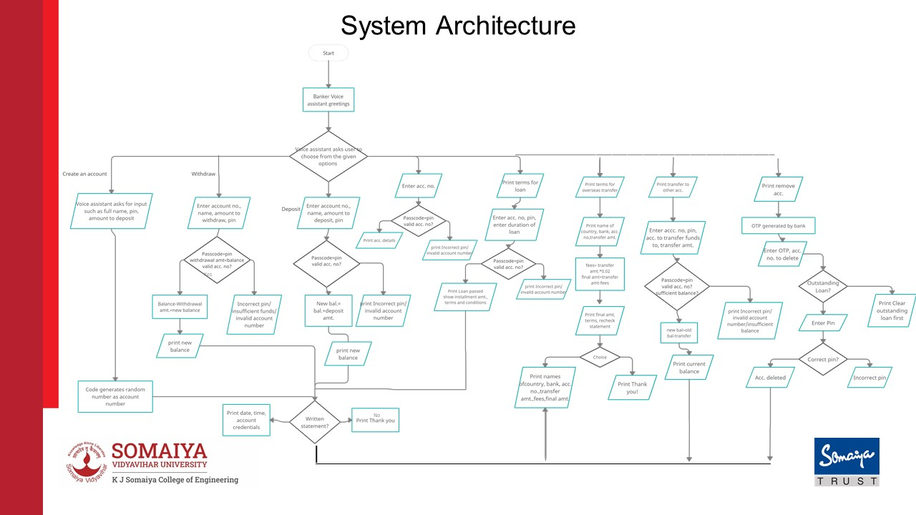
Overseas Transfer
Remove Acc.
Account Details
Loan
Transfer to other acc.
Yes
Yes
No
No
No
Yes
Yes
No
No
Yes
Yes
Yes
No
Yes
No
Yes
No
Notes:
Account Details

Slide 5
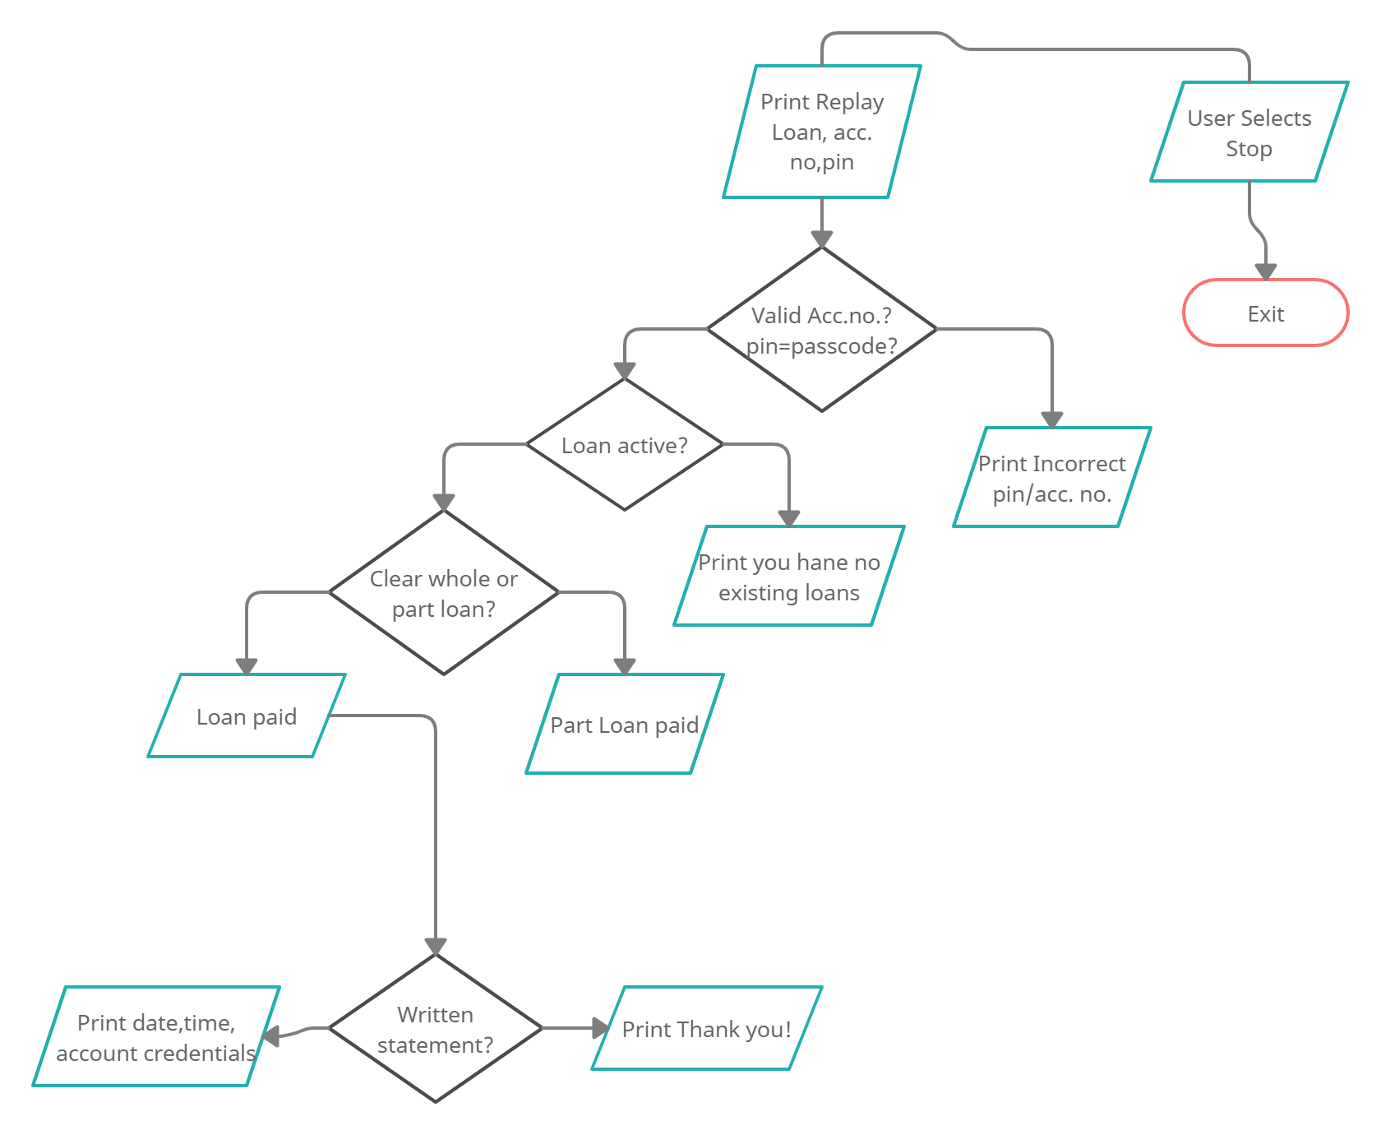
System Architecture (contd.)
Loan Repayment

Slide 6
Features of Designed System
We have designed “Banker” who will hear our commands and execute them. For example if the user says please open a bank account, the Banker will execute the command and show the information required to open a bank account.
Users can do the following using the code:
Voice Command to select choices
Create a bank account including a random assignment of account number
Deposit money
Withdraw money
Check customer details
Remove bank account
Loan facilities like lending and repayment of loan
Overseas transfer
Inter account transfer
Color-coded important texts
Print receipt for any transaction
Greet me function which greets according to real time

Slide 7
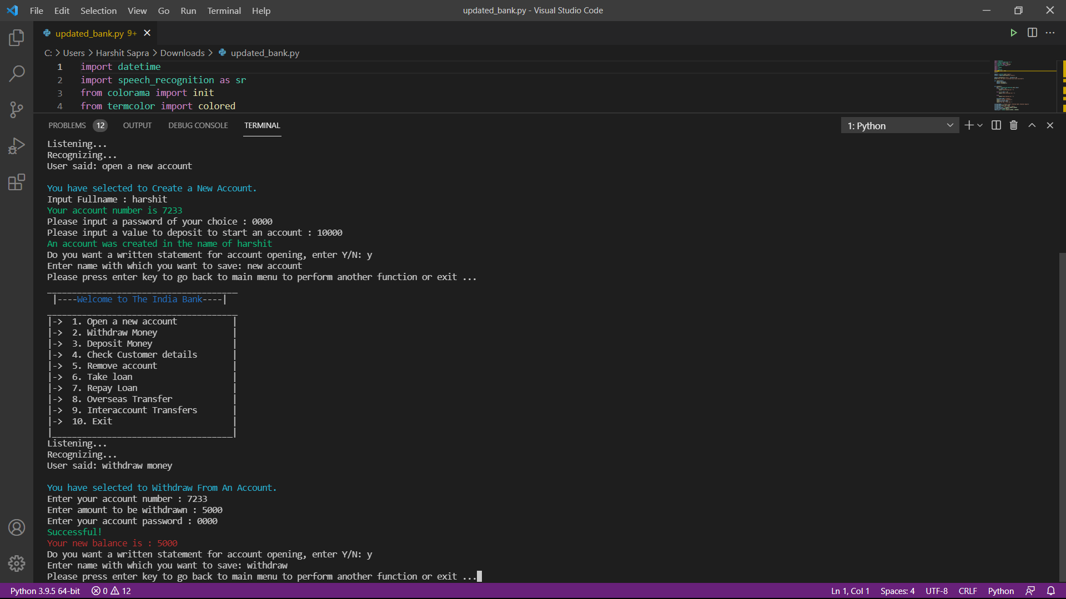
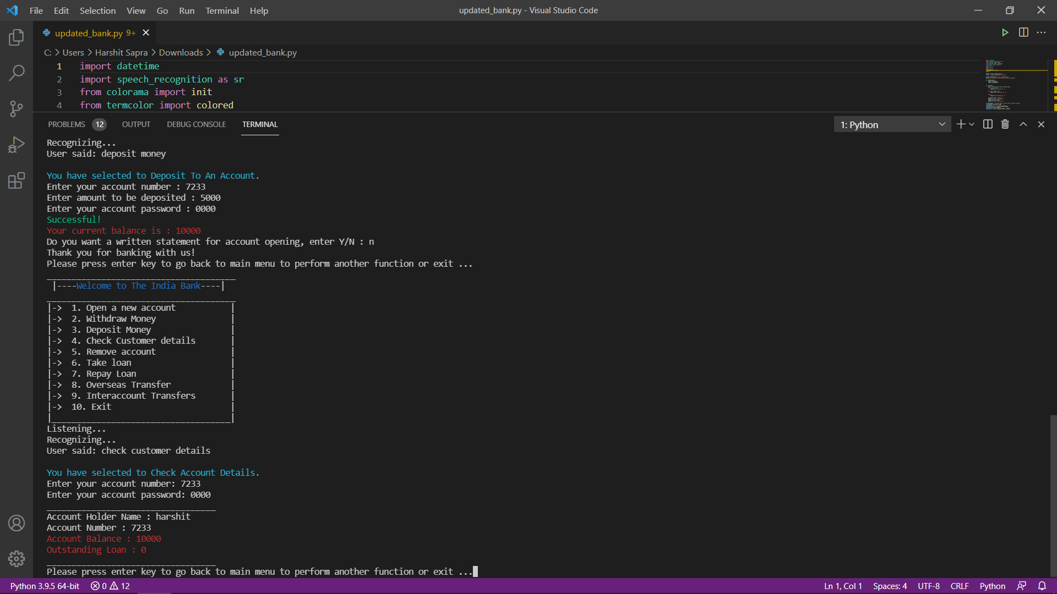
Result

Slide 8
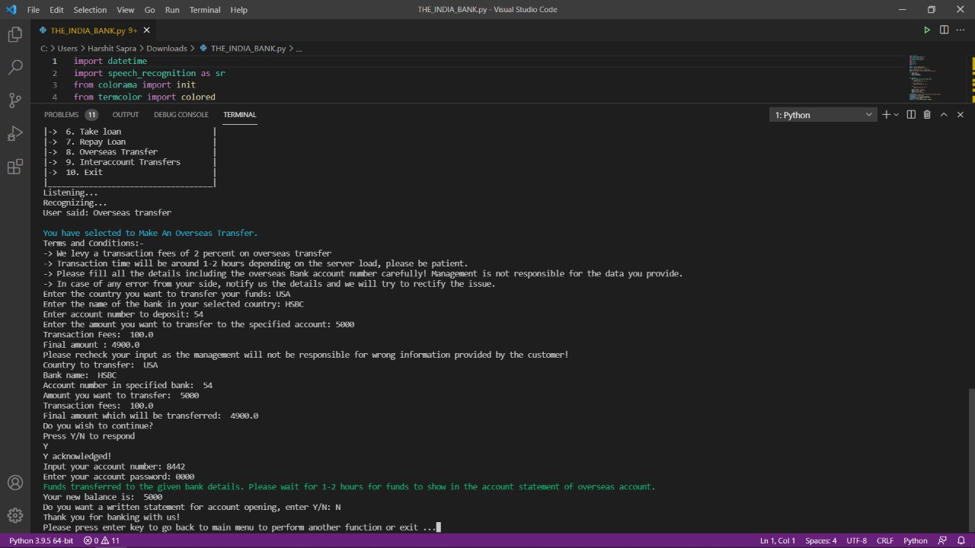
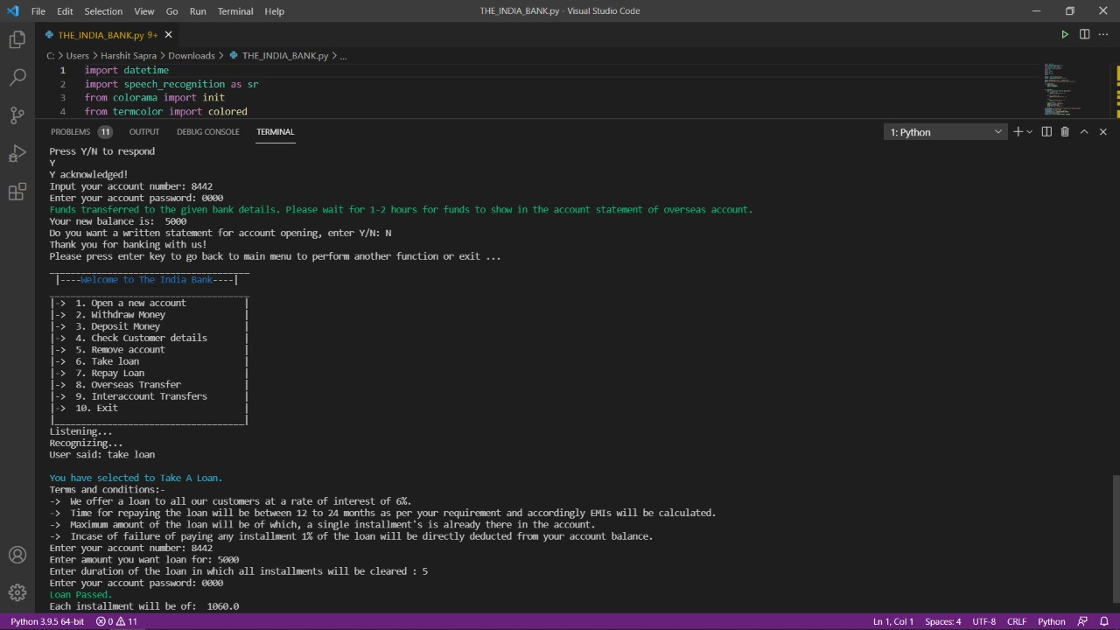
Result

Slide 9
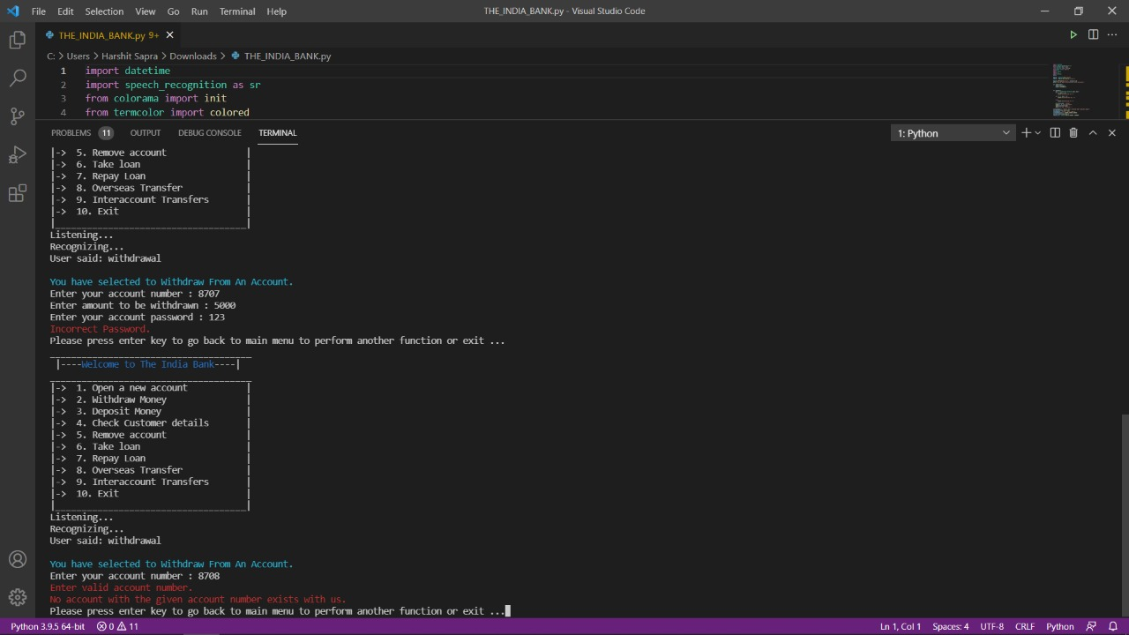
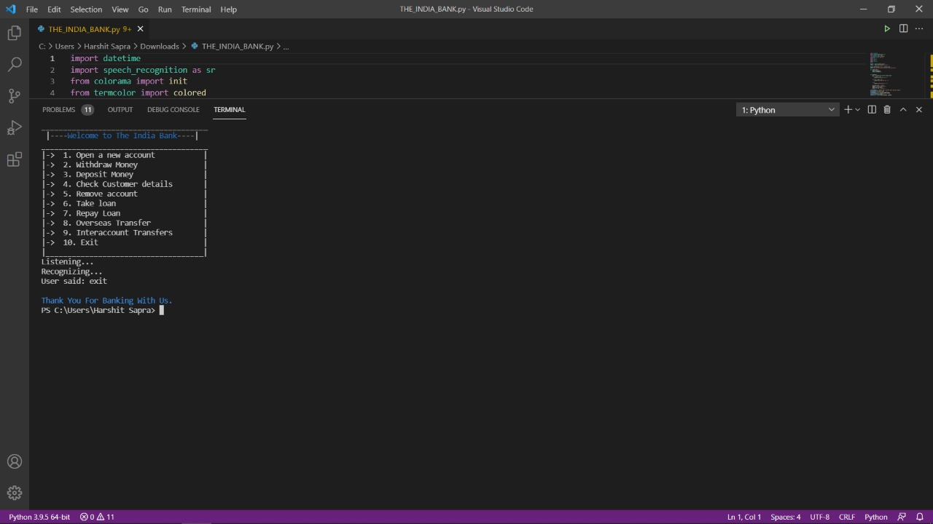
Result

Slide 10
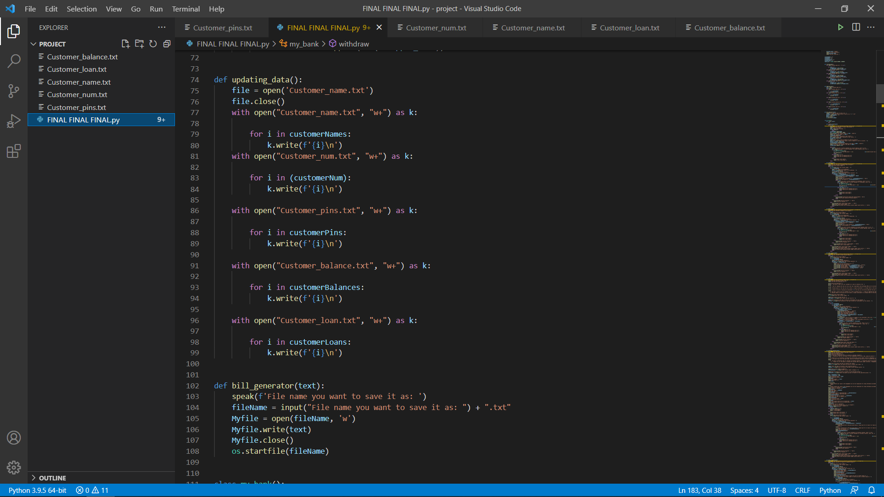
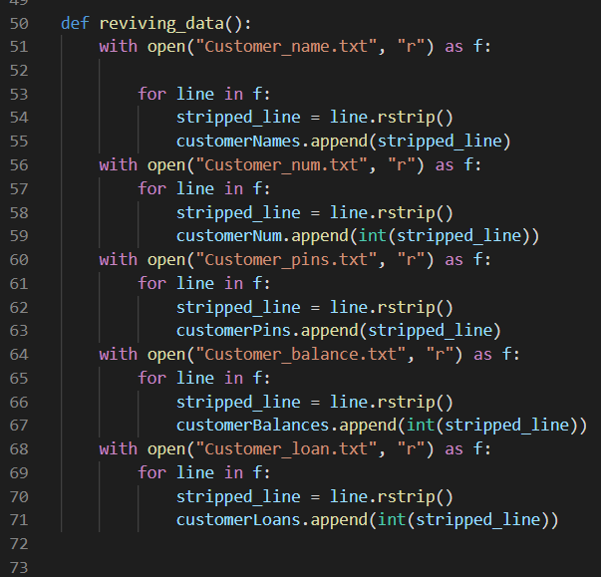
Result

Slide 11
Result
We have successfully implemented and executed various python modules like datetime, speech recognition, colorama, termcolor, OS, random etc.
We have designed a voice assistant who can hear the commands and execute them.
The voice assistant will greet users with real time greetings such as good morning, good afternoon etc.
We have made an option to print receipts of any/all transactions which includes date and time.
We have designed and implemented 10 features in our banking application.

Slide 12
Conclusion
Use of variety of libraries available in python in A banking management system was made. These libraries helped us make the program more user-friendly, hence, they play an important role in python coding. We have successfully implemented and executed various python modules like datetime, speech recognition, colorama, termcolor, random etc.
Classes and functions were used in the programming to organize the code and making it readable for others. It also helped us to organize the code and trim unnecessary repetition of lines of code.
Text to speech added to the code helps blind people to use the program as they are guided through by text to speech and give their inputs using a braille keyboard.
Using file handling the data of all accounts maintained properly and saved in an organized format.
Using the above mentioned points, the code works accurately and caters to all inputs from the users. Using the methods mentioned above, 10 banking features were successfully made.

Slide 13
Reference
https://medium.com/techtofreedom/5-ways-to-break-out-of-nested-loops-in-python-4c505d34ace7
https://stackoverflow.com/
https://www.w3schools.com/
https://www.geeksforgeeks.org/
https://www.programiz.com/
https://www.udemy.com/course/complete-python-bootcamp/
Project link:
https://github.com/akshatrshah/Python-Mini-Project

Slide 14
Thank You

